Slide 1

HOSPITAL PATIENT RECORD SYSTEM
Presented by,Mohammed Thanish A
FULLSTACK DEVELOPER(PYTHON)

Slide 2
Agenda
Introduction
Existing System
Challenges in Existing System
Proposed System
Features of Proposed System
System Module
Future Enchancements
System Architecture/Technology Stack
Conclusion
Program
Output

Slide 3

INTRODUCTION
Project Overview
The Hospital Patient Record System is a desktop application developed using Tkinter and MySQL. It aims to manage patient data efficiently with a user-friendly interface.
Purpose and Scope
This system allows storing, updating, and retrieving patient records in real time. It reduces manual work and enhances the accuracy of hospital record management.

Slide 4
EXISTING SYSTEM
Manual Record Keeping Most small hospitals still use paper-based systems to store patient details. This method is time-consuming and prone to human errors.
Limited Accessibility Patient records are stored in physical files, making access and retrieval difficult. Only one person can use the data at a time.
Lack of Data Security Paper records can be lost, damaged, or accessed without authorization. There is minimal control over who views or edits the information.
No Search or Filter Options Finding specific patient information takes time as there’s no digital search functionality. It often requires checking multiple files manually.
Difficult to Update Information Updating patient records involves rewriting or adding new pages. This can cause confusion and increases the chance of duplicate data.

Slide 5
CHALLENGES IN EXISTING SYSTEM
Data Inaccuracy Manual entry increases the risk of errors in patient records. Even small mistakes can lead to serious medical consequences.
Time-Consuming Processes Managing and locating patient files takes a lot of time. It slows down hospital operations and patient service.
Poor Data Management Physical storage leads to misplacement and duplication of records. Tracking a patient's history becomes difficult over time.
Limited Backup and Recovery In case of fire, water damage, or loss, physical records are hard to recover. There is no reliable backup system in place.
No Real-Time Access Doctors and staff cannot access updated records instantly. This delays treatment and affects decision-making.

Slide 6
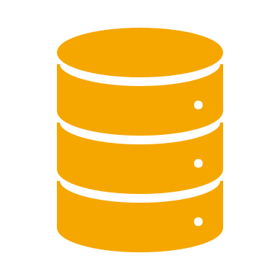
PROPOSED SYSTEM
1.Digital Record Management The system stores all patient records digitally using a MySQL database. This ensures fast, organized, and error-free data handling.
2.User-Friendly Interface Developed using Tkinter, the GUI is simple and easy to navigate. Staff can easily add, update, delete, or search patient records.
3.Secure Data Access Login-based access control ensures that only authorized users can manage records. This enhances privacy and patient data protection.
4.Quick Search and Update Built-in search and filter features allow quick access to specific patient data. Records can be updated in real time with a few clicks.
5.Backup and Recovery Support Digital storage allows for regular data backups and easy recovery. It reduces the risk of permanent data loss.

Slide 7
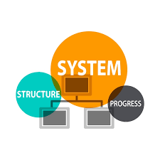
FEATURES OF PROPOSED SYSTEM
Add and Manage Patient Records Users can easily add new patient details and manage existing records. It supports editing, updating, and deleting entries.
Search Functionality The system allows quick searching of patient records using various filters. This saves time and improves efficiency in data access.
Login Authentication Secure login ensures only authorized users can access the system. This feature protects sensitive patient data.
Graphical User Interface (GUI) Tkinter provides a clean and interactive interface for easy usage. No technical skills are required to operate the system.
Database Integration All records are stored in a MySQL database for structured and reliable storage. Data is well-organized and easily retrievable.

Slide 8

SYSTEM MODULES
Login Module Provides secure access to the system with username and password. Ensures only authorized users can manage patient records.
Patient Registration Module Allows users to add new patient details into the database. Includes fields like name, age, gender, disease, and contact info.
Patient Management Module Enables updating, viewing, and deleting of patient records. Ensures records are accurate and up-to-date.
Search and Filter Module Lets users quickly search patient data using keywords or filters. Saves time and improves data accessibility.
Database Connectivity Module Connects the GUI with the MySQL database. Handles all backend data storage and retrieval operations.

Slide 9

FUTURE ENCHANCEMENTS
Doctor and Staff Management Add modules to manage doctor and staff details along with their schedules. This will help in overall hospital administration.
Appointment Booking System Integrate a feature for patients to book appointments online. It will streamline the patient visit process.
Medical History Tracking Store and display patients’ past medical records and treatments. Helps doctors make better clinical decisions.
Billing and Payment Integration Include a billing module to generate invoices and track payments. Makes the system more comprehensive and useful.
Cloud Storage and Remote Access Enable cloud-based storage for accessing records from anywhere. Useful for telemedicine and multi-branch hospitals.

Slide 10
SYSTEM ARCHITECTURE/ TECHNOLOGY STACKS
Frontend – Tkinter (Python GUI) Tkinter is used to build the graphical user interface. It provides interactive forms for user input and display.
Backend – Python Python handles the core logic, data processing, and control flow. It connects the GUI to the database and processes user actions.
Database – MySQL MySQL stores all patient records in a structured format. It ensures data integrity and supports fast queries.
Database Connectivity – MySQL Connector The mysql-connector-python library is used to connect Python with MySQL. It enables data insertion, updates, deletion, and retrieval.
Architecture – Two-Tier Model The system uses a two-tier architecture with a client interface and database server. This design separates the user interface from data storage for better performance.

Slide 11
Conclusion
The Hospital Patient Record System provides an efficient way to manage patient data digitally. It reduces manual errors, improves data access, and ensures better record security. Using Python with Tkinter and MySQL makes the system both powerful and user-friendly. This project lays a strong foundation for future enhancements in hospital management systems.

Slide 12
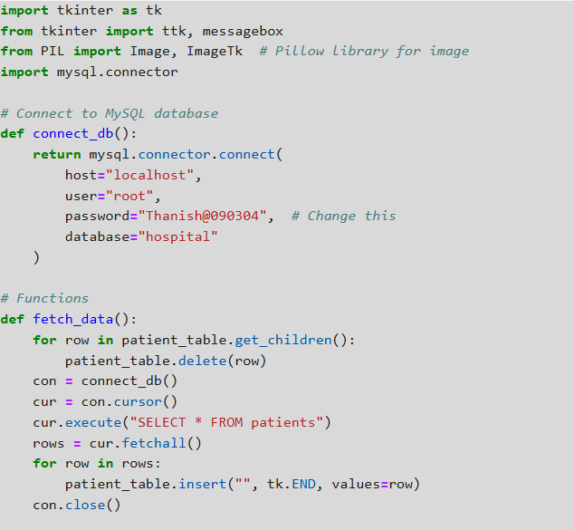
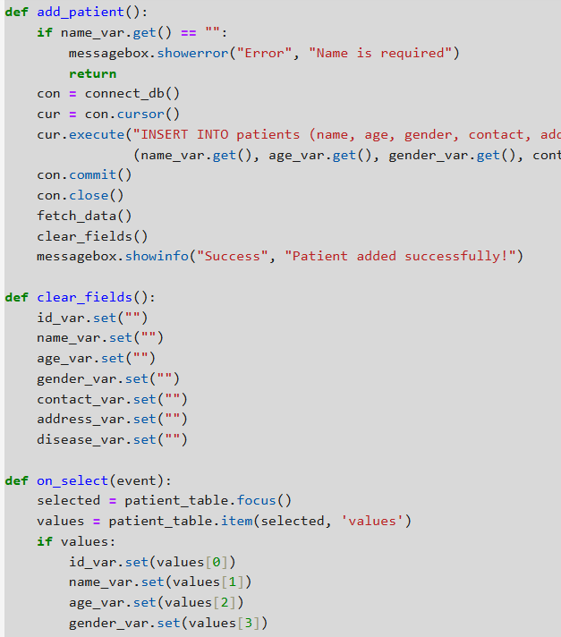
PROGRAM

Slide 13
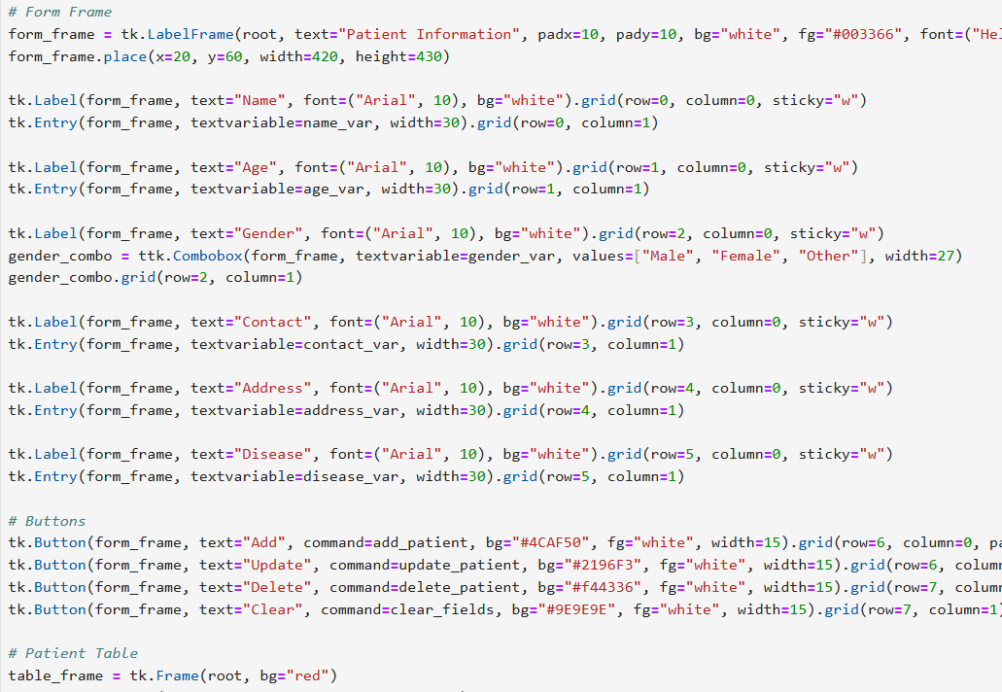
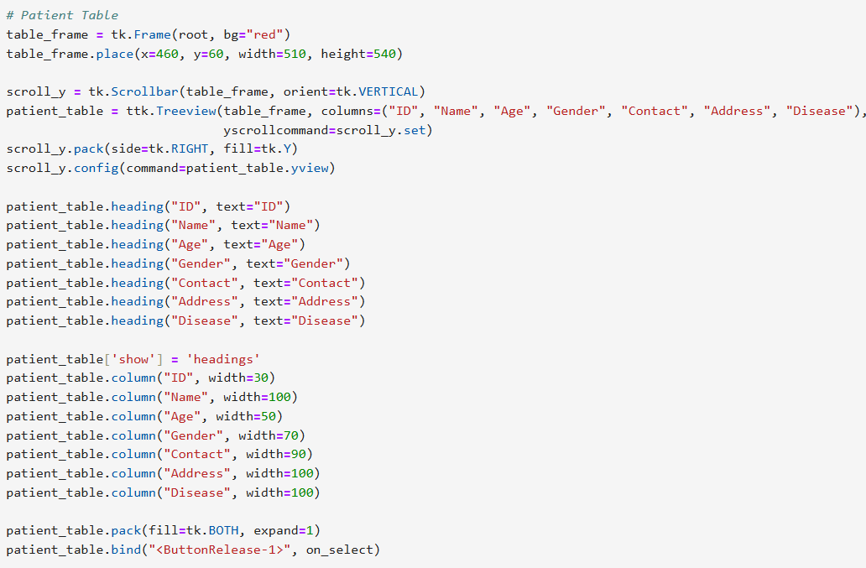
PROGRAM

Slide 14
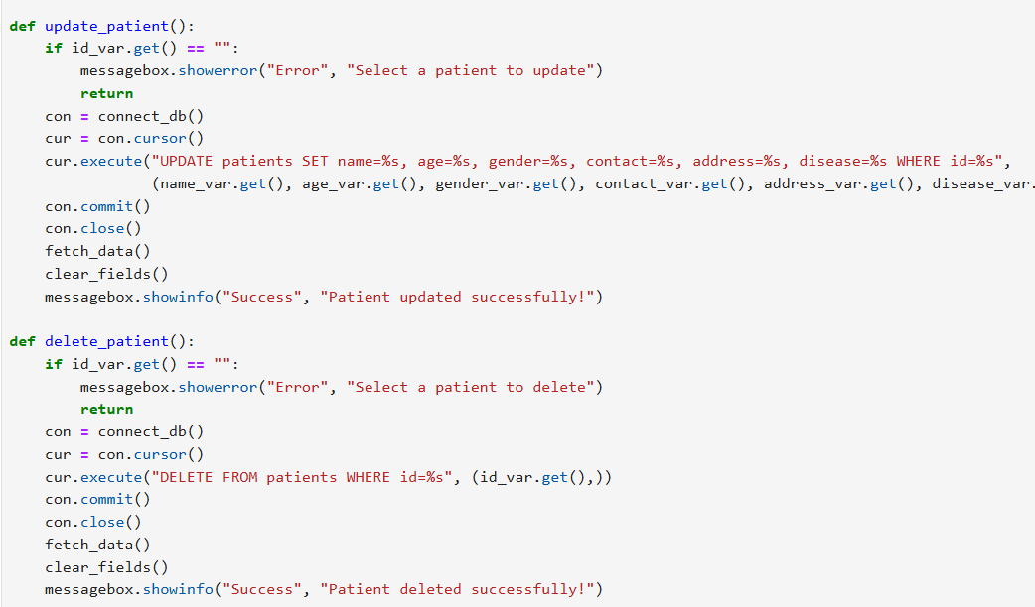
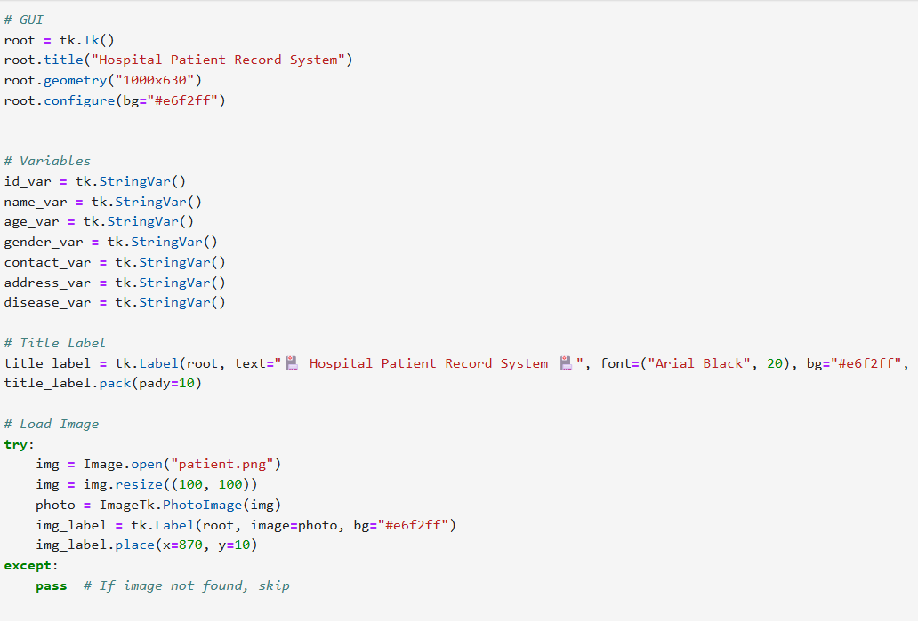
PROGRAM

Slide 15
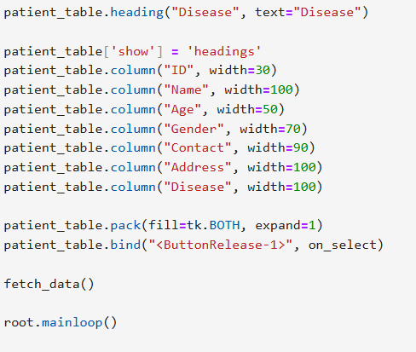
PROGRAM

Slide 16
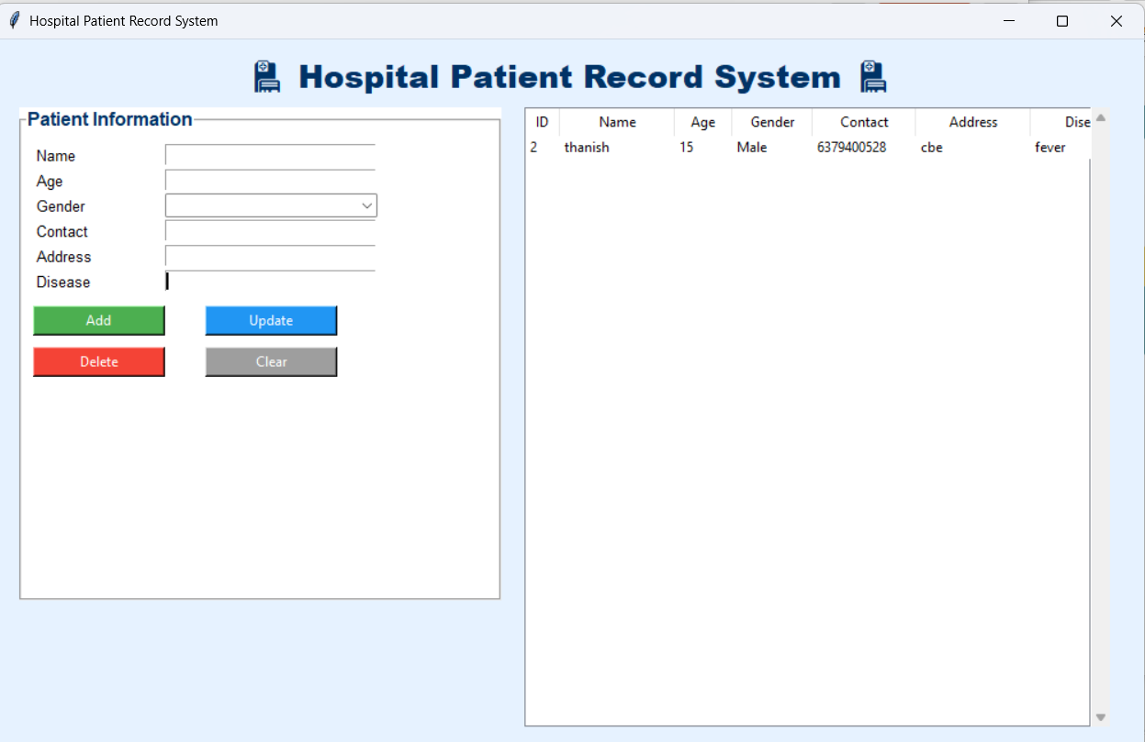
OUTPUT

Slide 17
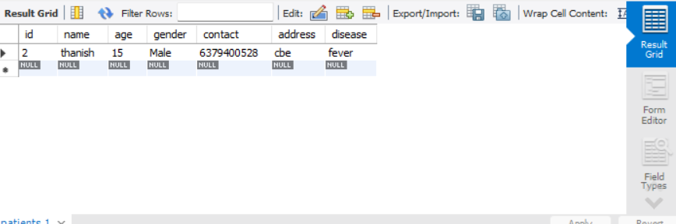
OUTPUT

Slide 18
THANK YOU

